Slide 1
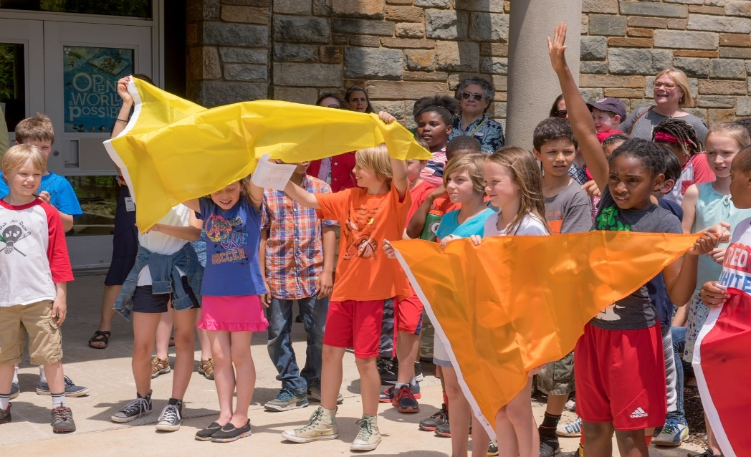


Air Quality Flag Program
Know the Air Quality
Forecast and Protect
Your Health
Notes:
I’m glad to be here today to talk about EPA’s Air Quality Flag Program.

Slide 2
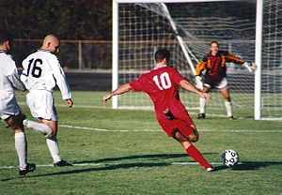
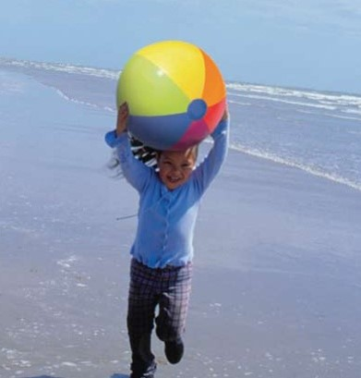

WHY IS AIR QUALITY IMPORTANT?
Millions of people in the U.S. are exposed to unhealthy air every year.
Ozone and particle pollution are the two most widespread air pollutants of concern.
Everyone can be harmed by unhealthy levels of ozone and particle pollution - especially people with asthma, heart or lung disease, older adults, children and teens, and people who are active outside.
Notes:
Has anyone ever died of air pollution? Yes, thousands! It’s not something we like to think about but the air we breathe can make us sick.
So why is air quality important?
Millions of people in the U.S. are exposed to unhealthy air every year. Today, we’ll be talking about the Air Quality Flag Program which is focused on protecting individuals from the harmful effects of air pollution. The two air pollutants of greatest concern is ozone and particle pollution .
Everyone can be harmed by unhealthy air - especially people with asthma, heart or lung problems, older adults, children & teens, and people who are active outside.

Slide 3
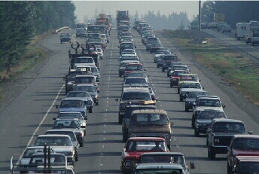
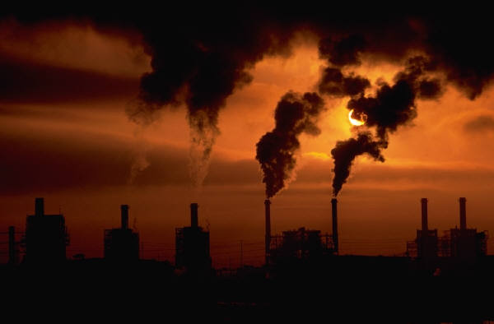
GROUND-LEVEL OZONE (O₃)
Ozone is a primary component of smog.
Ozone is not emitted into the air.
Ozone forms when nitrogen oxides (NOx) and volatile organic compounds (VOCs) react in the presence of sunlight.
Ozone levels can be high in urban and rural areas.
Notes:
Ground-level ozone is one of the two pollutants of concern and is sometimes called “bad ozone” to distinguish it from “good ozone.”
Good Ozone occurs naturally in the upper atmosphere and forms a layer that protects us from the sun’s harmful ultraviolet rays.
A phrase we teach students is ozone is “good up high” “bad nearby.”
Ground-level ozone is NOT emitted from a particular source but is formed by the reaction of volatile organic compounds (VOCs) and Nitrogen Oxides (NO_{X}) in the presence of heat and sunlight
Ozone is a concern in the summertime, because sunlight and hot weather accelerate its formation.
Ozone levels can be high in both urban and rural areas.

Slide 4
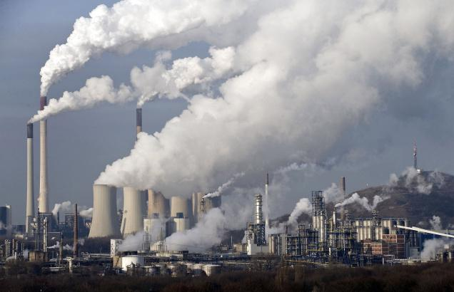
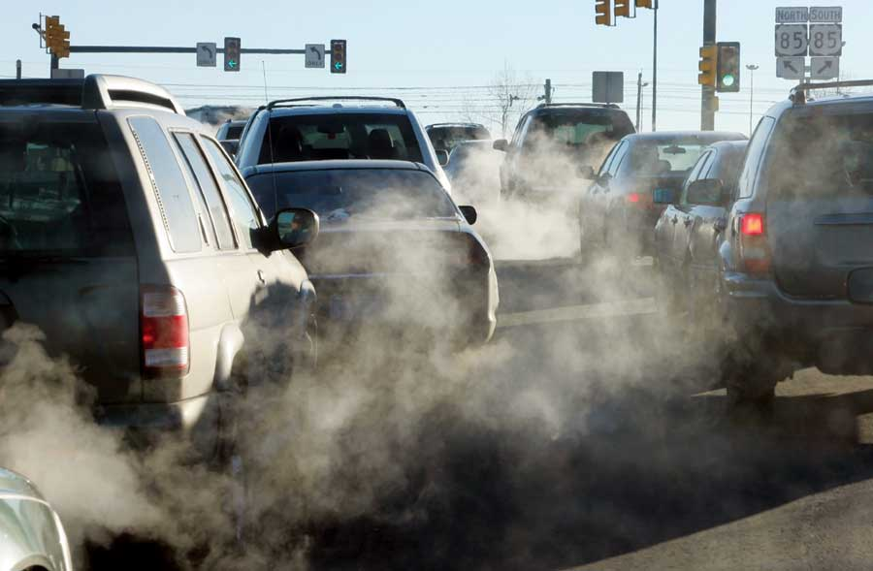
What Contributes to Ozone Pollution?
Motor vehicles
Power plants
Factories
Consumer & commercial products
Fuel combustion processes
Notes:
Here are some of the major man-made sources of the pollutants that form ozone (NOx and VOCs).
Consumer products such as vapors from gas cans, aerosols, etc. also contribute.

Slide 5
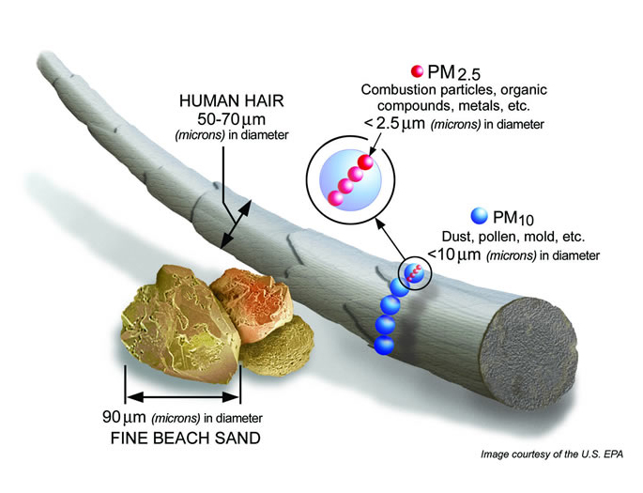
PARTICULATE MATTER: WHAT IS IT?
A complex mixture of extremely small particles and liquid droplets.
Notes:
The second pollutant of concern is Particulate Matter or particle pollution. Particle Pollution is a complex mixture of extremely small particles and liquid droplets found in the air.
Some particles are large or dark enough that they are seen as soot or smoke.
PM10 is less than 10 microns (blue round image) and PM2.5 is even smaller (the pink graphic);
This diagram is showing PM2.5 and PM10 compared to the a strand of human hair.
Notice that the hair is compared to a fine grain of sand.
The reason this air pollutant is of concern is that when inhaled these fine particles can cause serious health effects.

Slide 6
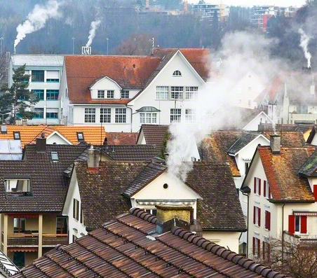
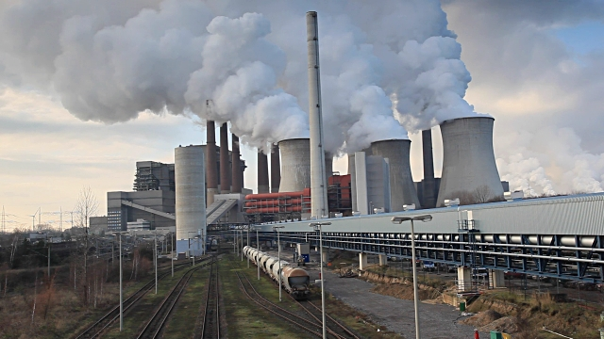
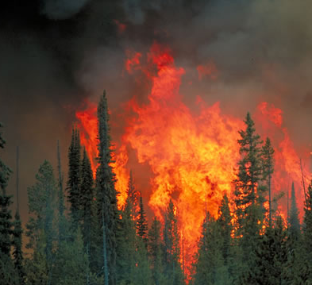
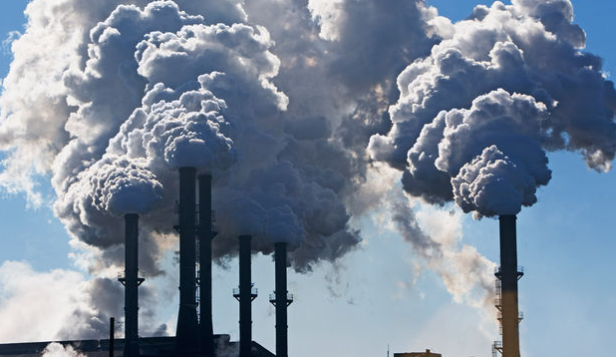
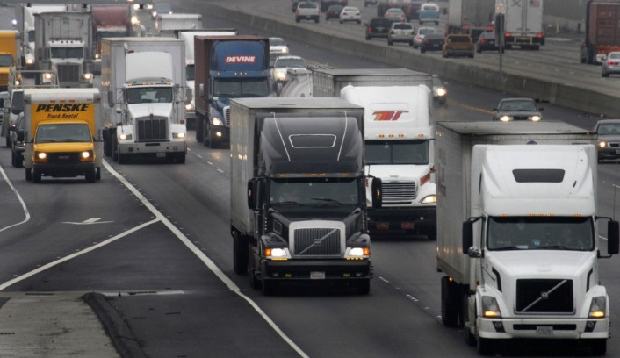
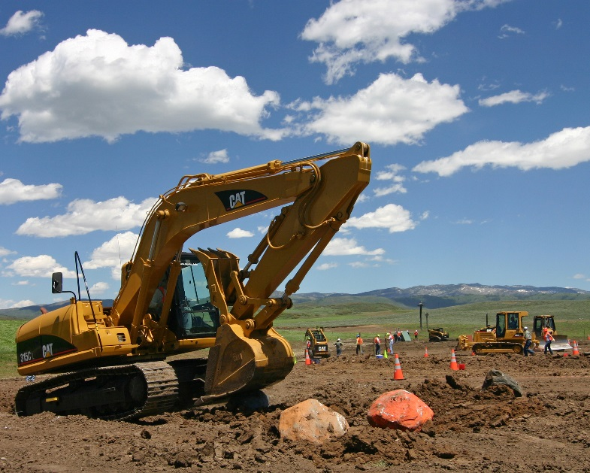

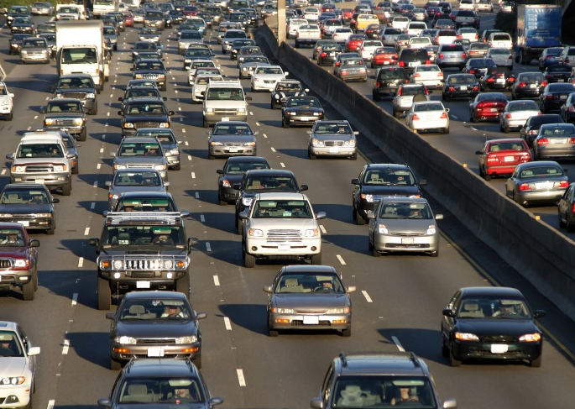
Wood-Burning Stoves
Power Plants
Forest Fires
Fine and Coarse Particles Can Be Emitted Directly or Formed in the Air from Gases
Industrial Sources
Heavy Duty Diesel Engines
Non-Road Vehicles
Natural Sources
Cars and Trucks
Notes:
Some particles come from natural sources, but the vast majority of particles are produced by human activities –
from cars, trucks and other vehicles,
industry, power plants and even wood stoves.

Slide 7





Ozone and particle pollution
Can cause coughing &
difficulty breathing
Can cause eye, nose & throat irritation
Can trigger asthma attacks
Can cause heart disease, abnormal heart rhythms, congestive heart failure, stroke, & premature death
Can affect the development of children’s lungs
Notes:
When ozone or particle pollution is at a high enough concentration, it can irritate your eyes, nose, and throat…
make it difficult to breathe,
make asthma symptoms worse,
affect the development of children’s lungs, and
even affect your heart.

Slide 8
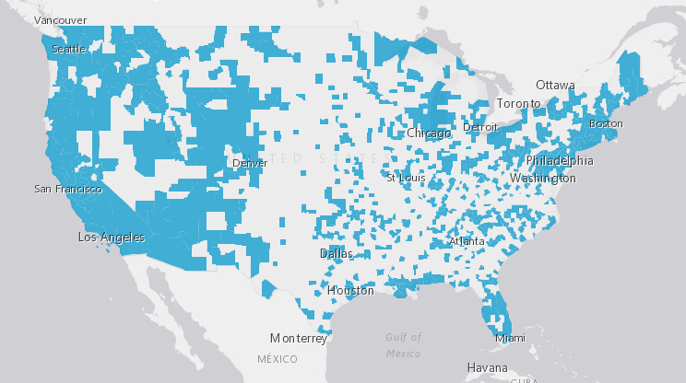
How has your air quality been?
Find out by using the Flag Program’s interactive story map at https://gispub.epa.gov/OAR_OAQPS/FlagProgram/
Scroll down to this story map page, then click on any blue county to see how many “unhealthy” air quality days have happened in the last few years.

Slide 9
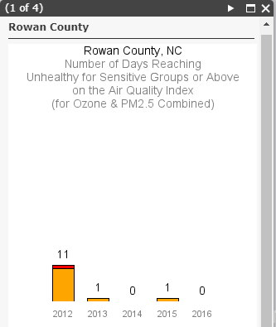
Example of historical air quality data

Slide 10
How do I know if I am breathing unhealthy air?
Check the Air Quality Index (AQI), a color-coded system for reporting air quality conditions. The colors in the AQI indicate how clean or dirty the air is. When the air quality is unhealthy, you can take actions to protect your health.
What Color is Your Air Today?
Good
Unhealthy for Sensitive Groups
Very Unhealthy
Moderate
Unhealthy
Notes:
You can’t always see air pollution. How can you tell whether or not the air you’re breathing is clean or dirty?
The Air Quality Index is a color coded system for reporting daily air quality. It tells how clean or polluted the air is, and the actions to take to protect your health when the air quality is unhealthy.
Green indicates good air quality
Yellow is moderate – which means it is acceptable for most people but there is a very small number of people that could still be affected,
Orange means unhealthy for sensitive groups (like children & teens, those w/asthma, older adults, & people with heart & lung disease)
Red signals unhealthy air for everyone
Purple is very unhealthy -- this would trigger a health alert signifying that everyone may experience more serious health effects.

Slide 11
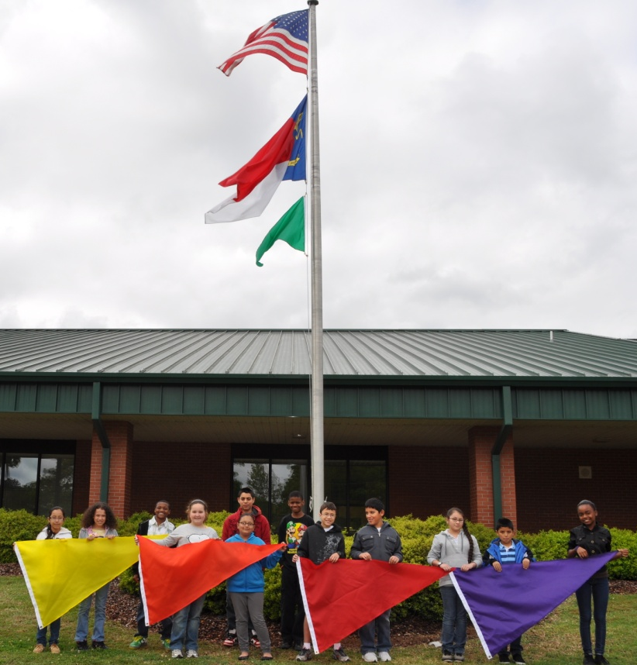
Air quality flag program: how does it work?
Schools and organizations raise a flag each day that indicates the air quality forecast: green, yellow, orange, red or purple.
When the air quality is unhealthy individuals can take actions to reduce exposure to air pollution.
Notes:
The Air Quality Flag Program was created initially in an area that has serious air pollution issues.
The air quality agencies there wanted to help teachers know when the air quality conditions were unhealthy so they could take measures to protect their students.
The flag program is easy to implement and easy to maintain and offers tremendous benefits to students, teachers, and members of the general public.
Here’s how it works: Schools and organizations raise a flag each day that indicates the color of the air quality index: green, yellow, orange, red and purple. The colors are based on EPA’s Air Quality Index.
When the air quality is unhealthy individuals can take actions to reduce exposure to air pollution.
This is especially important for those who have asthma.

Slide 12




Four easy steps to get a flag program started
1
2
Purchase flags
Educate and inform
the community
3
4
Check the air quality forecast each day and fly the corresponding flag color
Follow the recommendations for outdoor activities
Notes:
On the flag website at www.airnow.gov/flag you’ll find a Quick Start Guide on how to get a flag program started.
There’s just four easy steps:
First you’ll need to purchase a set of flags.
It’s important to educate and inform the community.
You’ll need to check the daily air quality forecast and fly the corresponding flag color.
Follow the recommendations for outdoor activities.

Slide 13
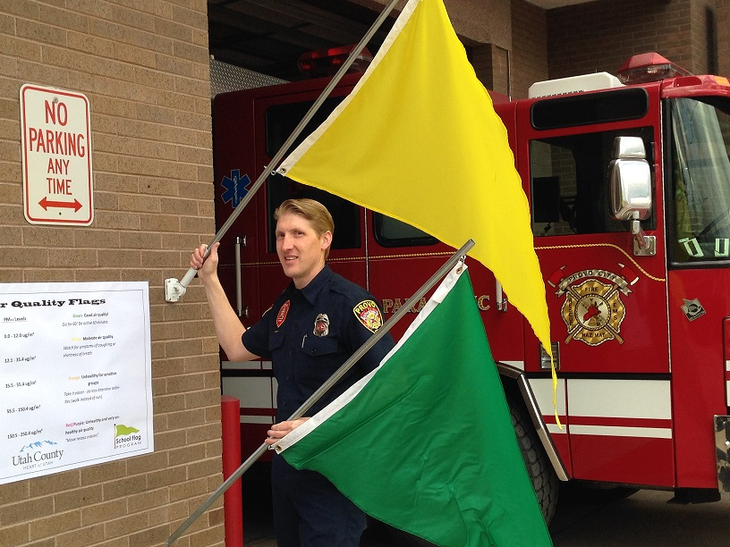
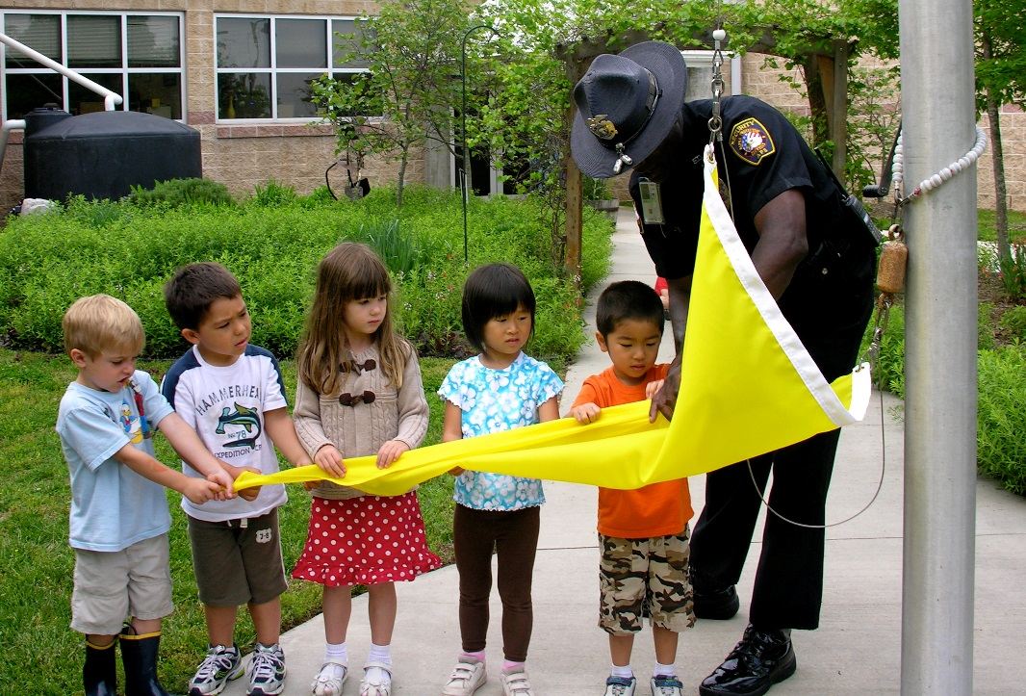
Purchase flags
Cost is approximately $100 for a set of five flags
Search “order air quality flags” to find online vendors
Use pennant style flags, 5 x 3 ft.
Notes:
The first step is to purchase your flags:
A set of 5 flags can be purchased for $100 or less.
We suggest asking the school PTA or PTO to fund the flags, a local asthma coalition or business.
3. Search “order air quality flags” to find online vendors.
4. The program uses pennant style flags, 5 x 3 ft. and the pantone colors are available on the website.
5. We recommend plain flags - logos or graphics can be added, although they are not easily seen from flag pole and it adds to the cost.

Slide 14



Educate and inform
Educate and inform the community, teachers, parents and employees about the flag program.
Recruit one or two people to be the Flag Program Coordinator(s); in schools, teachers, nurses and coaches make great champions for the program.
Get the message out through:
  Emails
  Social media – Facebook & Twitter
  Flyers
  Poster
  Local newspaper
  Newsletters
  Word-of-mouth
  Flag Event
Notes:
Next it’s important to let your school and surrounding community know about the program and what the flags mean. Educate the community with enthusiasm…get your students excited and they will go home and tell their parents.
There are letter templates available on the website that you can use to spread the word. You can include information in newsletters, emails, etc.
A flag event is a good way to involve your community, invite the press, and promote the program. Tips For Having a Flag Event one pager is available on the website.

Slide 15

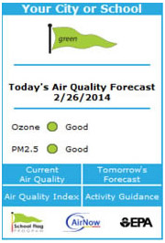
Check the air quality forecast each day
Subscribe to ENVIROFLASH: The free air quality forecast will be sent to your email.
  www.airnow.gov/enviroflash
Download the free AirNow APP available at
  www.airnow.gov
You can install a WIDGET to show local air
quality on your website.
Notes:
One important aspect of the program is to know how and where to check the air quality forecast each day.
You can involve students and have them check the forecast and raise the flag.
They can even make morning announcements to let all the students and teachers know the air quality forecast for the day. A script for the morning announcements is available on the website.
There are several ways to check the air quality forecast:
Subscribe to EnviroFlash to get an email each day. It’s free and easy to subscribe.
Download the free AirNow APP available at www.airnow.gov.
Or install the widget for a convenient way to check the forecast

Slide 16
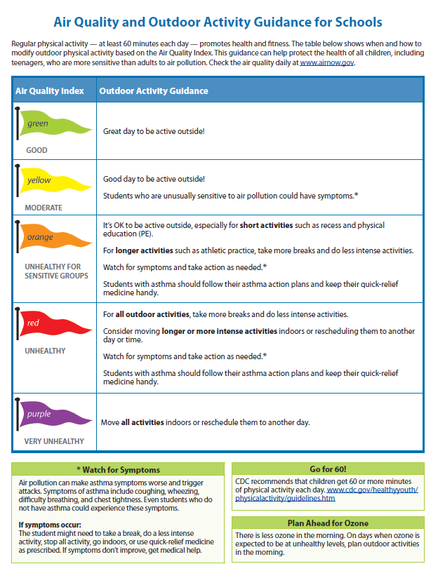
Recommendation for outdoor activity for schools
Notes:
These are guidelines and recommendations for outdoor activity for Schools.
If a code red ozone day is expected and you are a coach, have your players take more breaks and do less intense drills.
Or if it’s a code red ozone day teachers can move outdoor activities scheduled for the afternoon to the morning hours.

Slide 17
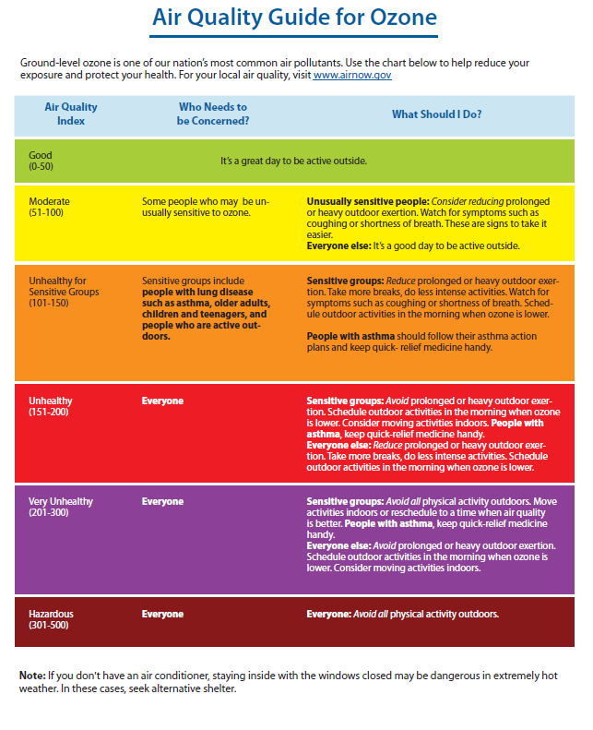
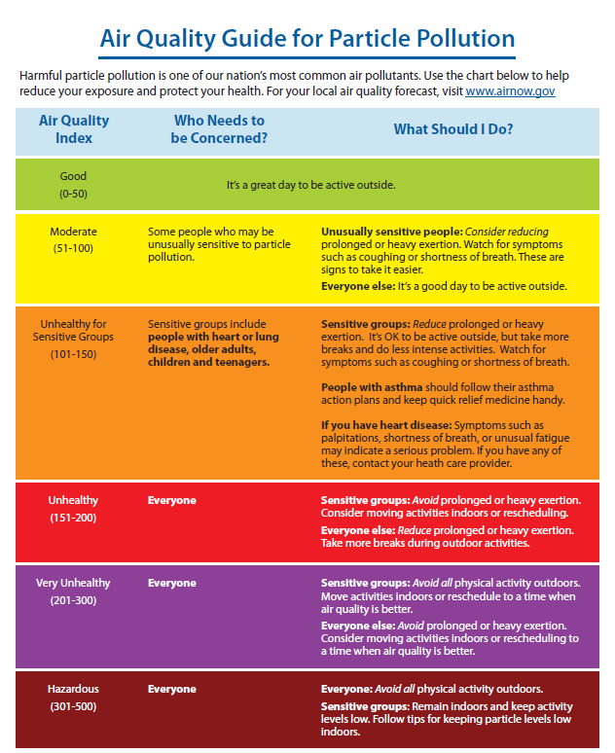
Recommendations for outdoor activity for ozone and particle pollution
Notes:
These are guidelines and recommendations for outdoor activity.
The health benefits of regular exercise is well documented. The intent of these guides are to help people continue to exercise while protecting their health when air quality is unhealthy.
For example: If you plan to go for a run and it is expected to be a code red ozone day, it is better to go for your run in the morning. This is because ozone levels are higher in the afternoon and early evening.

Slide 18


When the air quality is unhealthy
Avoid spending too much time being physically active outdoors
Always avoid exercising or biking near high-traffic areas
Choose a less-strenuous activity (e.g., walk instead of run)
Limit outside activity to the early morning hours or wait until after sunset
Notes:
No matter how fit you are, reducing the duration or intensity of outdoor activity at times of unhealthy air quality will help protect you from the harmful effects.
We all know that exercise has positive health benefits, so the goal is to stay active.

Slide 19
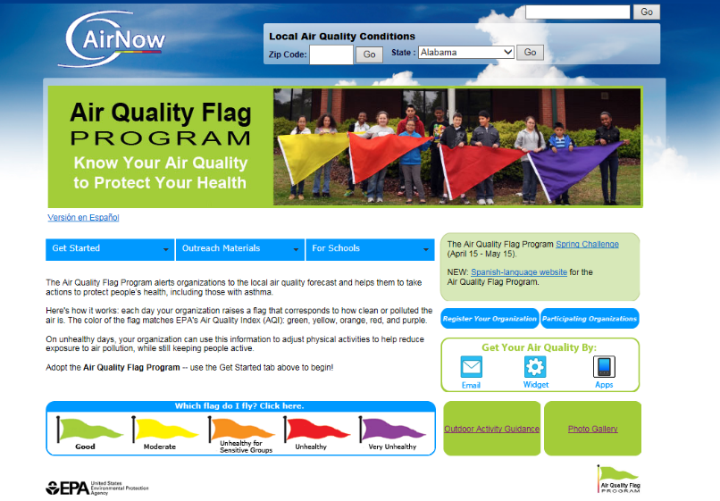
Flag program website
Free Resources Available!
Fact sheet (English and Spanish)
Coordinator’s Handbook
Recommendations Chart/Activity Guidelines (English and Spanish)
Press Release Template
Sample emails to employees and
school parents
Registration Form
Student lessons
Teacher and student resources
www.airnow.gov/flag
Notes:
The activity guidelines and many other resources can be found on the flag program website.

Slide 20

Tips to reduce air pollution
Do at least one or more of these actions every day!
At home:
  Turn off the lights when you leave a room
  Run dishwashers and clothes washers only when full
  Avoid burning leaves, trash, and other materials
At work or school:
  Turn off office equipment after hours
  Print and photocopy on both sides of paper
  Start an alternative transportation program to encourage biking, walking, or carpooling
On the road:
  Refuel your car in the evening when it is cooler
  Avoid idling and schedule errands together
  Take public transportation
Notes:
And we all need to be reminded to do our part to reduce air pollution.

Slide 21
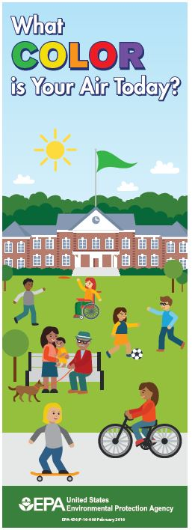
Benefits of the
Air Quality Flag Program
The Air Quality Flag Program raises awareness of air quality and air pollution issues for K-12 students and members of the general public.
The program helps students and the public better understand the Air Quality Index and the health messages associated with each color.
The Air Quality Flag Program can help reduce exposure to air pollution and protect those who have asthma, people with heart or lung disease, older adults, children and teens, and people who are active outside.
The flag program is an environmental education program that can help a school achieve recognition as a “Green School.”
The flag program is easy to implement and easy to maintain.
Notes:
In conclusion, I want to remind you of the benefits of the flag program:
The Air Quality Flag Program raises awareness of air quality and air pollution issues for K-12 students and members of the general public.
The program helps students and the public better understand the Air Quality Index and the health messages associated with each color.
The Air Quality Flag Program can help reduce exposure to air pollution and protect those who have asthma, people with heart or lung disease, older adults, children and teens, and people who are active outside.
The flag program is an environmental education program that can help a school achieve recognition as a “Green School.”
The flag program is easy to implement and easy to maintain.

Slide 22
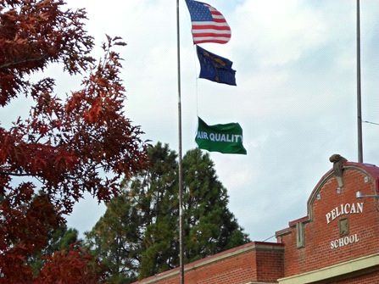
contact
Local Contact:
Notes:
Please feel free to contact me if you have questions.

