Slide 1

AIRNow: Real Time Air Quality
Air Quality Workshop for Teachers
Date
Name of Speaker
Notes:
The AIRNow website was launched in 1998 to share real-time information about air pollution. AIRNow is a public information system,
using real time data and forecasts to help the public make decisions to protect their health.

Slide 2



Health Effects of Air Pollution
Air pollution affects everyone
Aggravates
  lung disease, including asthma
  heart disease, including congestive heart failure
Resulting in:
  More premature deaths
  More admissions to hospitals
  More trips to emergency rooms
  More visits to doctors’ offices
  More school and work absences
  More symptom days
Notes:
Air Pollution affects everyone and aggravates…

Slide 3
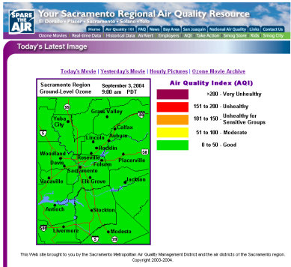
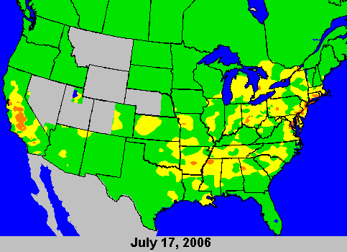
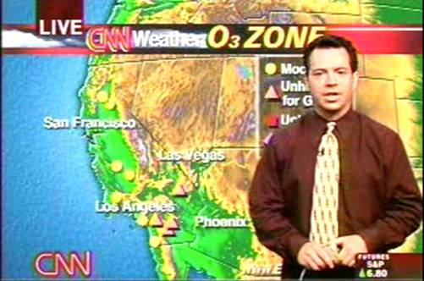
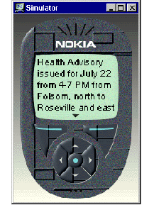

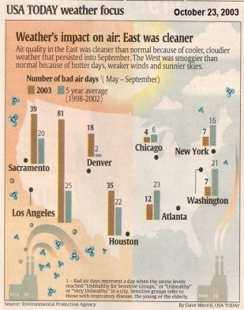
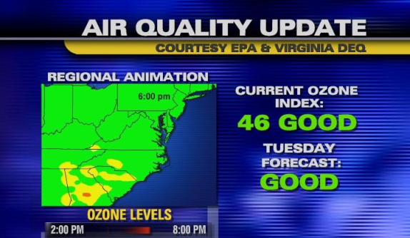

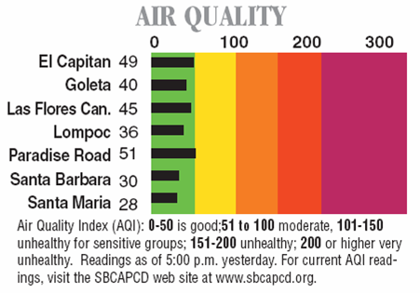
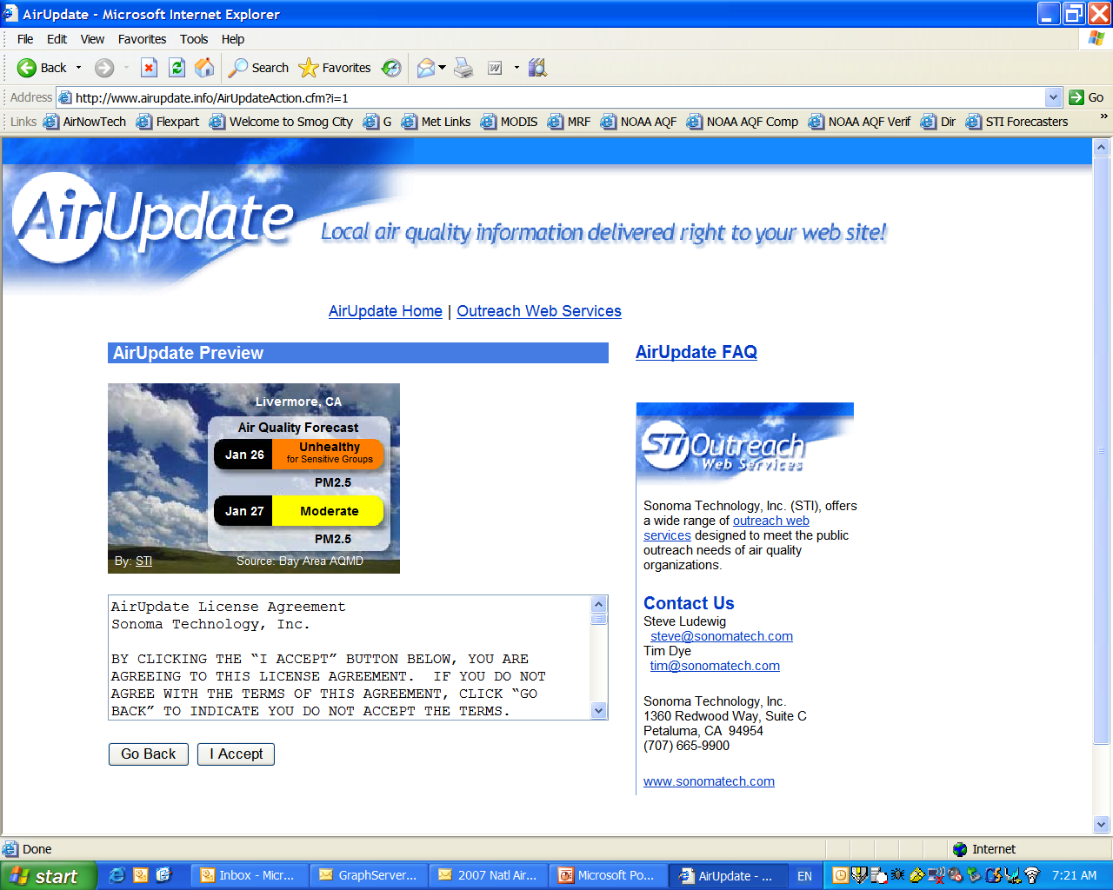
About AIRNow
What AIRNow does
Coordination
Centralization
Air Quality Index conversion
Education
Distribution
Air Quality Data
45
62
215
55
125
485
Air Quality Forecasts
Notes:
AIRNow provides a central, national system to receive, process, and distribute air quality data. It uses the Air Quality Index (AQI) to ensure that the public always gets air quality and health messages in a consistent manner.
AIRNow sends data to weather service providers, media outlets such as CNN, The Weather Channel, and USA Today, as well as providing the data to other web sites.

Slide 4
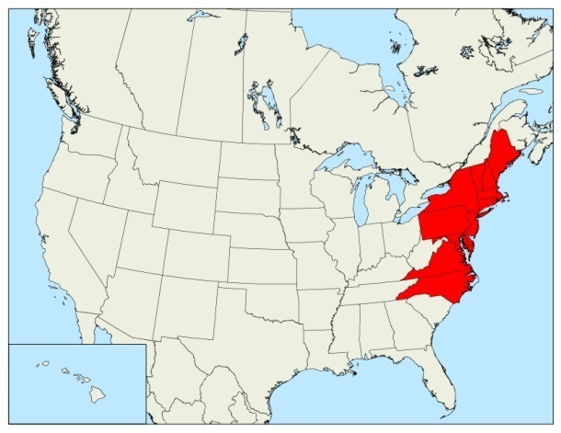
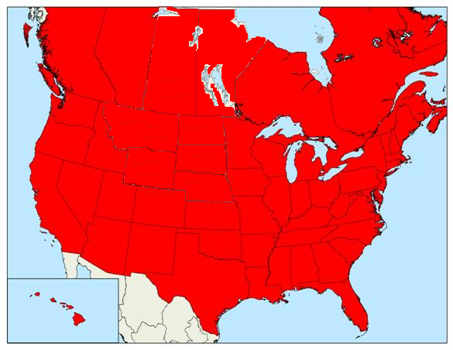
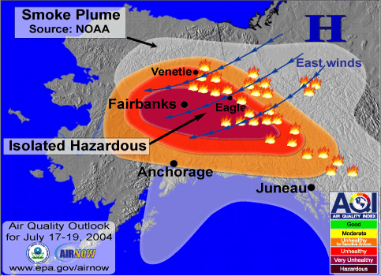
About AIRNow
Began in 1997
Funded by United States Environmental Protection Agency (EPA)
Diverse stakeholder community
  Federal, state, provincial, tribal and local air agencies (120+)
  Scientific and health research organizations (15+)
  Media and public outreach groups (30+)
Education and outreach
Substantial growth and data exchange
International activities
1997
2007
Observations
AIRNow
Data
Management
Center
Data
Media
Decision
Makers
and
Public
120+ State and Local Air Agencies
Maps and Forecasts
Internet
Forecasts
Notes:
AIRNow was an entirely voluntary program. There are no regulations requiring submission of realtime data.
The system began in the NorthEast US and spread across the nation by 2007. The system has proven invaluable for air quality information, as shown by this graphic of air quality during the Alaska wildfire event.
AIRNow is also being recognized internationally as other nations look to the program as a model.

Slide 5
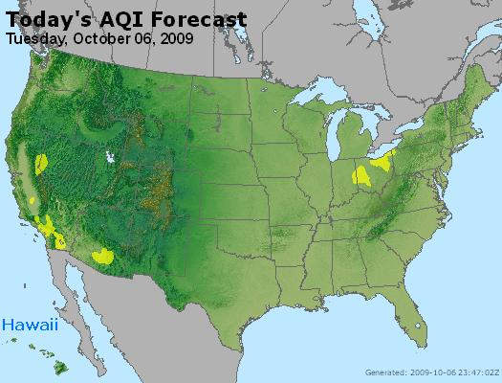
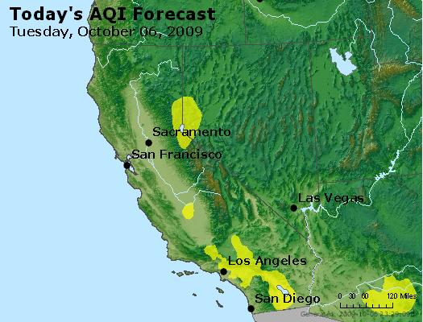
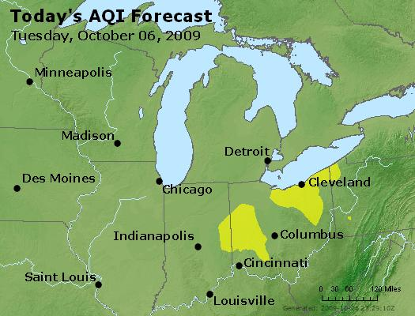
AIRNow Products
Real-time, hourly maps and data
Forecasts (300+ cities)
News stories, e.g. wildfires
Web cams (air quality)
Seasonal air comparisons
Notes:
AIRNow produces many realtime data products, but also features news stories and seasonal comparisons, to help the public understand how air quality is affected by special events and how one season might compare historically.

Slide 6
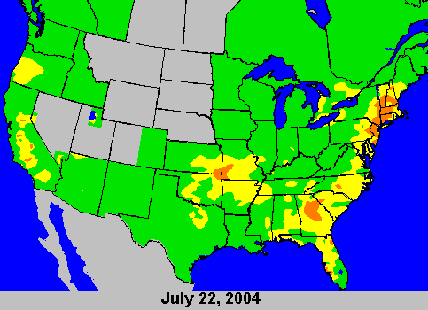

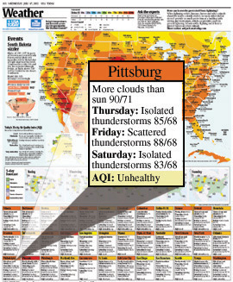






Communication
Local air agency websites
AIRNow web site
National Media
Data and Forecasts
h
Cell phone and pagers
Newspaper
Local Media
Decision Makers and Public
Other Media Outlets
Notes:
AIRNow’s data and forecasts are used in many different ways and are carried in all kinds of media.

Slide 7
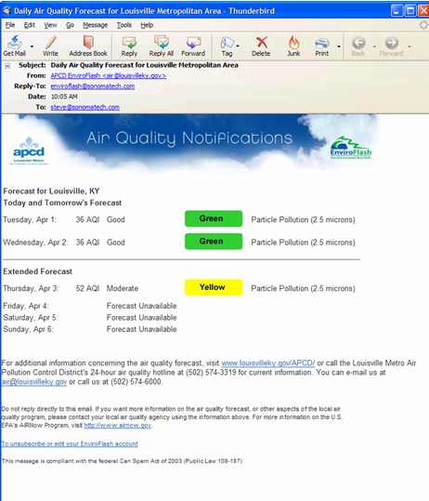

www.enviroflash.info
Real time air quality alerts
State and local environmental agencies configure their own “look”
Subscribers can receive full, graphical e-mails or short text messages for mobile devices
Subscribers manage their own accounts and choose the level at which they are notified
Notes:
This slide is an example e-mail from the EnviroFlash system. EnviroFlash allows the user to subscribe to receive an e-mail when the AQI is expected to be at a user-determined level of concern. So, you can sign up for Code Orange if you have asthma, for example.

Slide 8
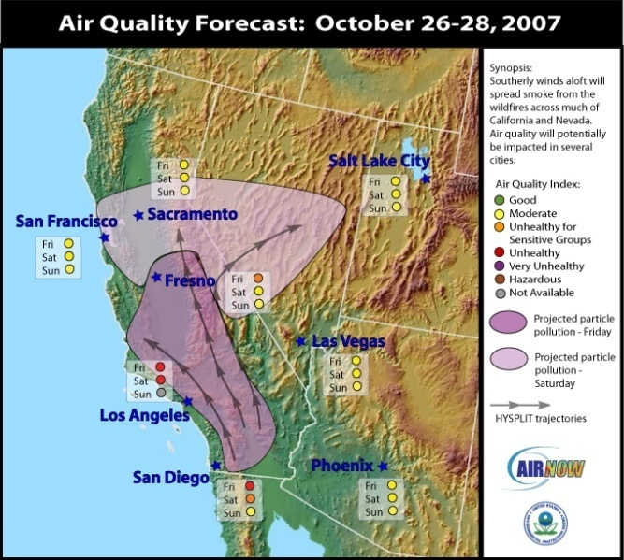


AIRNow’s “Human Side”
It’s not just a system, it’s a community
Annual conference
Regional cooperation
Daily interaction with stakeholders
Support during air quality events, emergencies
Leveraging state, local, and federal resources by collecting and distributing data back to partners, as well as to media outlets
Notes:
AIRNow, being voluntary, required an active community. That community was fostered by much interaction. The result was a leveraging of resources that allowed the community to accomplish great things at the national level. AIRNow was even featured in a management text called “Spiral Up”, which featured government programs that achieved great success by relatively unconventional means.

