Slide 1
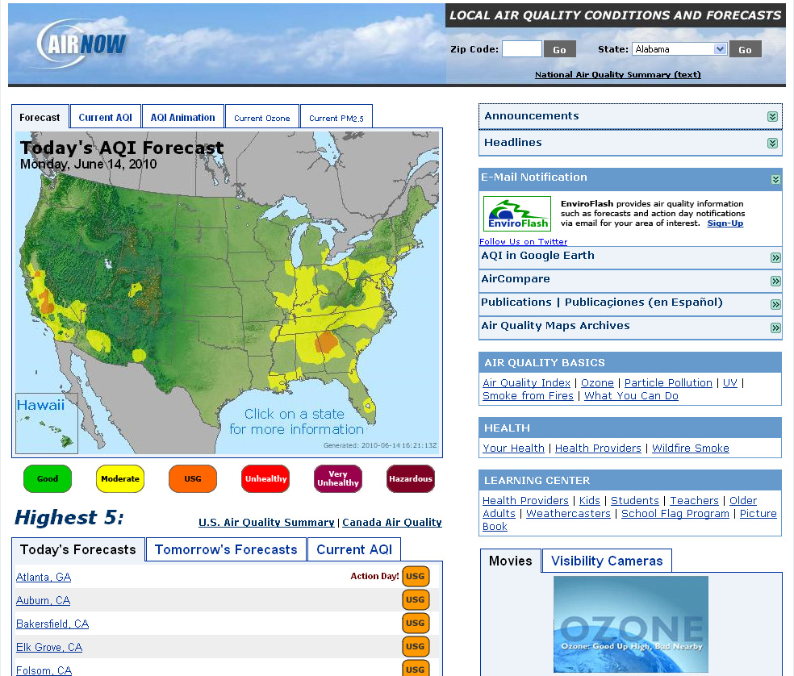
Notes:
I want to talk to you about some resources and tools we have for students and teachers on the AIRNow website.
We have several resources under the Learning Center
Kids
Students site
Teachers resources

Slide 2
Important for Students
Children (18 and under) - sensitive group
  lungs not fully developed
  should take precaution when the AQI is Orange or higher
Learn ways to reduce air pollution
Notes:
This is important because children (18 and younger) are part of a sensitive group.
Their lungs are not fully developed, and
They should take precaution when the AQI is Orange or higher.
Sensitive groups include active children and adults and people with respiratory disease. When the AQI is red, unhealthy, then the general public, especially children, are encouraged to limit prolonged outdoor exertion.
Also, we would like kids to learn ways to reduce air pollution.

Slide 3
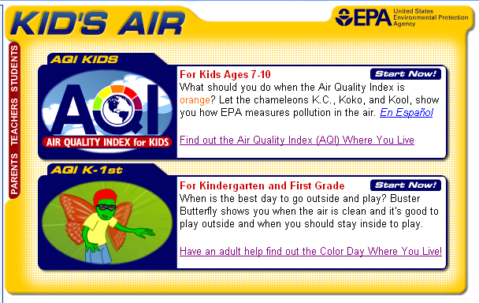
Kid’s Pages
Notes:
Our Kid’s site is divided into 2 sites. One for ages 7 - 10 and one for K – 1.
These sites explain the AQI to Kids.

Slide 4
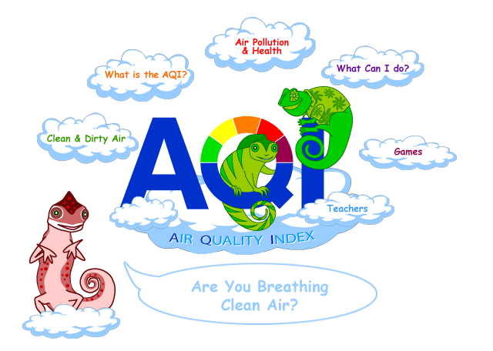
Notes:
Our Site for 7 - 10 year olds features 3 chameleons that explain the Air Quality Index, because the AQI uses colors to indicate air pollution levels.
This site is divided into several sections: “Clean and Dirty Air,” “What is the AQI?,” “Air Pollution and Health,” “What Can I Do,” “Games,” and resources for “Teachers.”

Slide 5
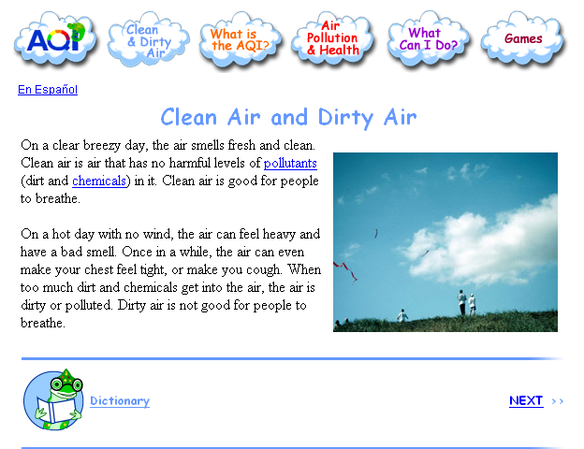
Notes:
I wanted to point out that each section has a storybook (no scrolling) layout with pictures and 1 or 2 paragraphs of text per page. We use Previous and Next to navigate through the site.
The underlined words can be found in the Dictionary.
Spanish version is available.

Slide 6
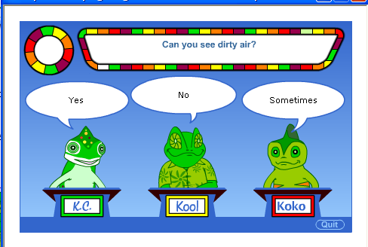
Games
Notes:
Here is an example of one of the games, which is the section the kids often go to first.
The game show features the 3 chameleons as contestants and the user must pick the chameleon with the right answer.
The trick is you have to read the information on the site before you can answer the questions in the game.

Slide 7
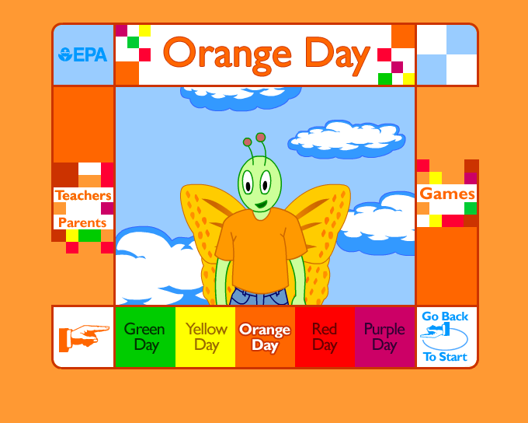
Notes:
We also have a site for Kindergarten / first grade. This site features a talking butterfly (with sound) and has very simple messages. This site has sound because some children this age can’t read. This site also has games for younger kids.
The butterfly explains how hard (or not hard) to play each day.
So on a green day the butterfly can play hard or fly fast.
But on an orange day, he has to take it easy.

Slide 8
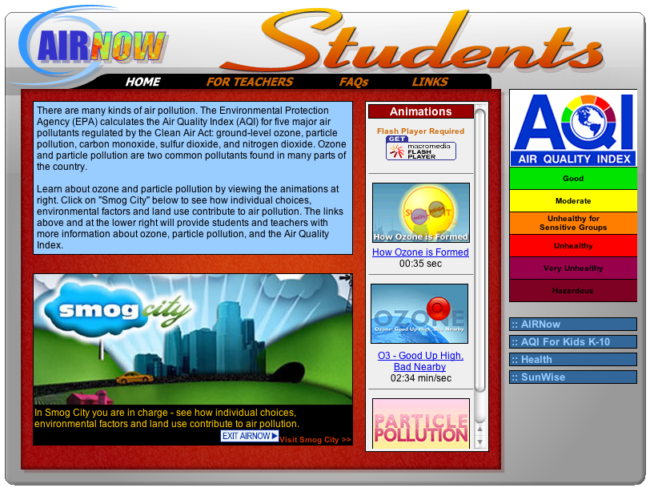
AIRNow Students Website
Notes:
The AIRNOW student’s site highlights Smog City 2. This site features several animations so students that aren’t familiar with ozone and particle pollution can read the background information before they enter Smog City.
The animations are: 1) How Ozone is Formed, 2) Ozone: Good Up High, Bad Nearby and 3) Particle Pollution.
How ozone is formed shows that ground level ozone is not naturally occurring or directly emitted. It is formed when nitrogen oxides and volatile organic compounds combine in the presence of sunlight.

Slide 9

Notes:
Smog City 2 is an interactive Web site that teaches students how weather and human activities affect ground-level ozone and particle pollution.
This is the new Smog City 2 main page. We have a short explanation about Smog City 2 and the Visitors Tour Guide (including system requirements) and Instructions for how to use the controls.
The entry to the simulator is in the lower left clouds. The icons read “Save Smog City 2 from Ozone” and “Save Smog City 2 from Particle Pollution” and “Create Your Own Experience.”

Slide 10
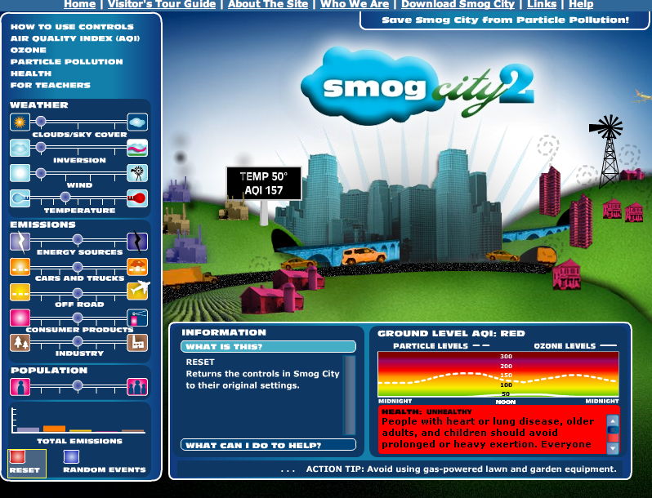
Notes:
“Save Smog City from Ozone”
- Instructions for lesson with printable worksheet
- Minimize
Cityscape – bright sunny hot day with lots of factories and cars and trucks
- Temp 90
- AQI 175
Health message is red
AQI diurnal chart
Point of lesson – reduce red to green
Adjust only emission controls to see how different emission sources affect ozone formation
Return to middle - AQI Orange
Raise temp - ozone AQI increases to Red
Add more clouds - decrease AQI back to Orange

Slide 11
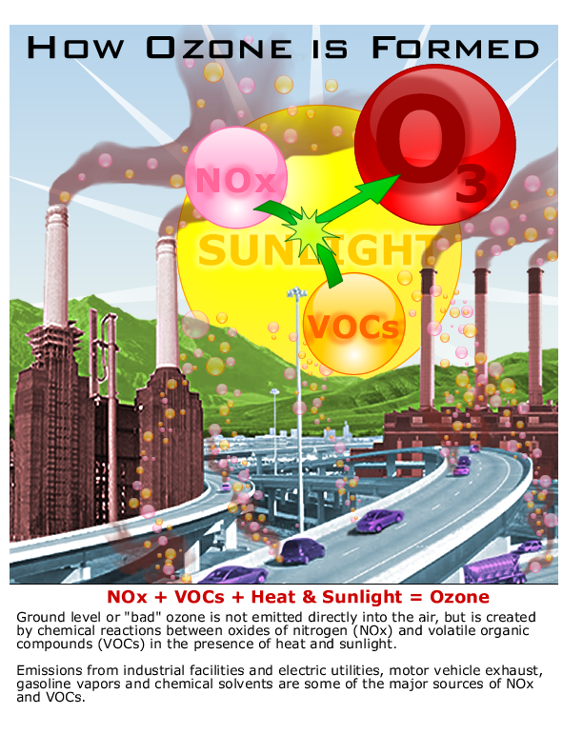
Teachers Resources
Instructions
Student worksheets
Flyers
Movies/Animations
Links
Notes:
What are system requirements?
Browsers: (Windows) Internet Explorer 6.0, Netscape 8.0, Firefox 1.0, Opera 8.0
Browsers: (MAC) Safari 1.2, Opera 9.0
Screen resolution: 1024 x 768 pixels or higher
3 MB of available hard disk space (standalone version only)
Flash 7 or above plug-in or player installed.

Slide 12
Contact Us
Lori Tussey
tussey.lori@epa.gov
919-541-4825
Donna Rogers
rogers.donna@epa.gov
919-541-5478
Notes:
Insert your own contact information. Please contact Lori or Donna if you do have questions.

