Slide 1


Welcome to the
Name
Email
Date

Slide 2
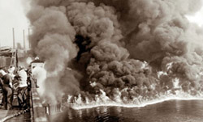
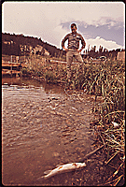
EPA was established in 1970 – a time when rivers caught fire…
Rail car accident set the oily Cuyahoga River on fire in 1969
Photo Credit: Cleveland State University Special Collections
Dead Fish in Grand Lake, CO
1972 epa.gov

Slide 3
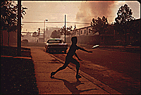
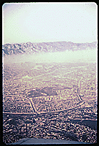
… and cities were hidden under dense clouds of smoke
Smokey Skies in Birmingham, 1972, epa.gov
Los Angeles Smog, 1972, epa.gov

Slide 4
Before EPA….
Increase in throw-away packages such as cans, bottles, plastics, & paper and thousands of new man-made chemicals in 1940’s (WW II)
Raw sewage, industrial, and animal wastes discharged into rivers and lakes
Toxic chemicals dumped in steel containers were often found when the containers rusted, leaking hazardous materials into soil and water
Emissions from factories & cars caused air pollution so bad that in some cities people got sick and some died

Slide 5
People Were Dying from Air Pollution
Donora, PA - 1948
  Air pollution from zinc factories & heaters
  Residents kept their lights on during the day
  Football team couldn’t see their opponents
  20 people die & over 7,000 are sick
  Years later, patches of land with no plants
London
  600 deaths from smog in 1948
  Smog responsible for 4,000 deaths over 4 days in 1952
New York
  Smog kills ~200 in 1953

Slide 6
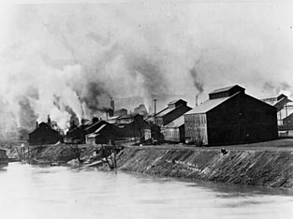
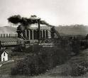

Denora, Pennsylvania – October 1948

Slide 7
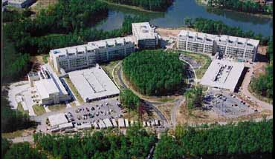
Who is the EPA?
EPA’s 17,000+ employees are lead by the Administrator, who is appointed by the President of the U.S. and confirmed by the U.S. Senate
Our Mission is “… to protect human health and the natural environment, air, water, and land, upon which life depends.”

Slide 8
EPA leads the nation's environmental science, research, education, & assessment
Develops and enforces regulations
Offers financial assistance, including research grants, graduate fellowships, & programs such as Brownsfields and Safe Drinking Water
Performs environmental research
Sponsors voluntary partnerships and programs
Furthers environmental education
Publishes information

Slide 9
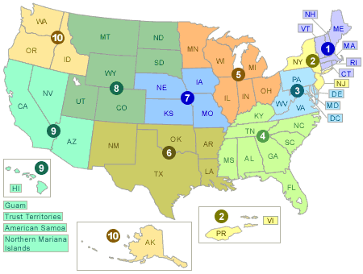
Where are we located?
Headquarters in Washington, DC
10 Regional Offices
Laboratories
  RTP
  Cincinnati
  Las Vegas
  Great Lakes
  Atlantic, Pacific, Gulf
EPA RANKED ONE OF THE TOP 10 FEDERAL WORKPLACES FOR 2007!
10 Regional Offices

Slide 10
Occupations at the U.S. EPA

Slide 11
Educational Background

Slide 12
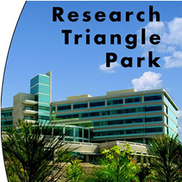
The EPA in North Carolina
One of the largest employers in NC's Research Triangle Park (~2,000 people)
Over 50% of EPA employees have an advanced degree
Longest stretch of solar powered roadway lighting in the U.S.
EPA’s largest building outside of Washington, DC

Slide 13
For more information…
http://www.epa.gov/

