Slide 1

The
Air Quality
Flag Program
Melissa Payne
US EPA
July 12, 2016
Notes:
Melissa Payne, Air Quality Flag Program team
Who has ever heard of an Air Quality action day, or heard the air quality is orange or red today? Well, that’s what we’re going to talk about today.
Who has heard of the FP, outside of this conference? Let’s see a show of hands. Does anyone already have a flag program at your school? (what school)

Slide 2
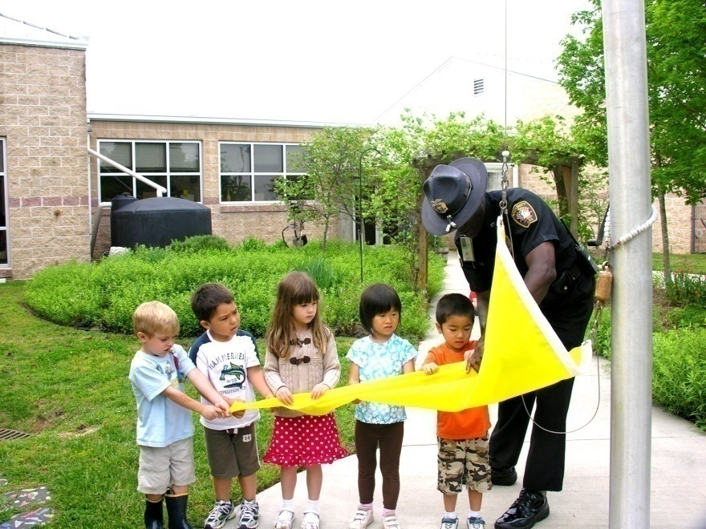
Content
Background on the flag program
How the AQFP works
EPA resources

Slide 3
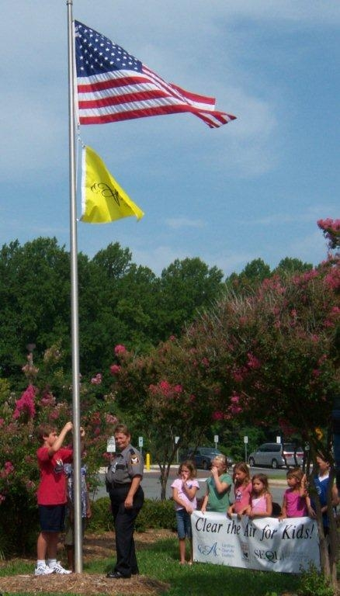
History
    2004- present: San Joaquin Valley starts school flag program
    2010: EPA creates a national program for schools
    May 2015: Expanded to include other organizations
Notes:
In 2004, the San Joaquin Valley Air Pollution Control District partnered with the American Lung Association of California (ALAC) and the Valley asthma coalitions to raise air-quality flags in schools. As some of you may know, certain parts of California struggle with poor air quality year round. The program was started to help protect childrens health by reducing exposure on bad air quality days
Other schools thought this was a great idea
2010: EPA creates a national program to promote and maintain consistency across the country
Other organizations thought this was a great idea as well, and we started hearing of fire stations, businesses, and others who were flying the flag. So..
Last year at this time,…and today
Because this is a school audience, that’s what we’ll focus on today

Slide 4
How it Works
School raises a flag each day
The flag color indicates the local air quality for the day
Students and staff look to the flag and understand what it means
Guidance on what to do when the air quality is poor
Notes:
School raises a flag each day-Flags match the colors of the Air Quality Index
how to modify outdoor activities

Slide 5
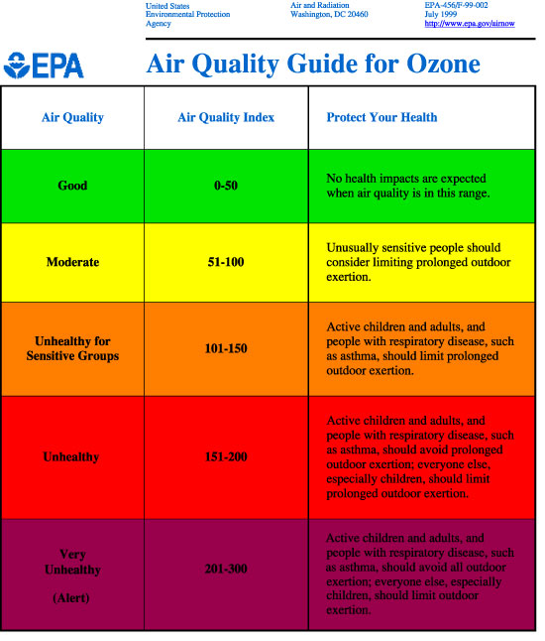
Notes:
Who has seen this before? On what color do you need to start thinking about changing your activities? What about kids? What about kids with asthma?
These are the AQI colors, and they’re also the flag colors.

Slide 6




AQFP: 4 Steps
    Purchase flags
    Educate school and community
    Check the daily forecast & fly the flag
    Follow the outdoor activity guidance
Notes:
0. Get school approval and find someone to be the point person.
What do you think the hardest step would be for your school?

Slide 7
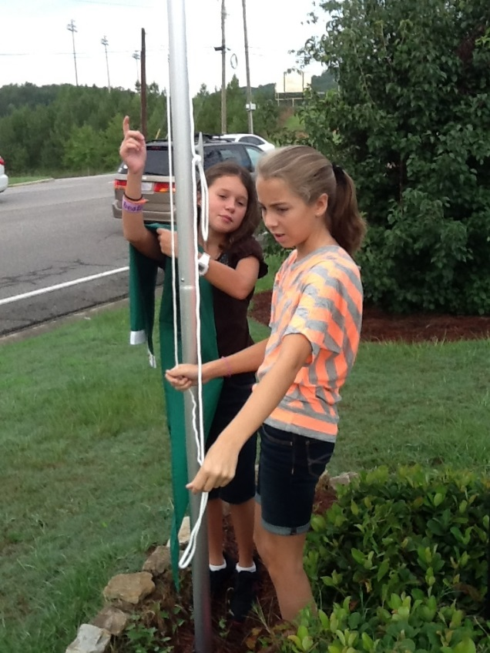
1. Buy Flags
Around $100
Funding: PTA, local health organization, business,
state air agencies, EPA regions, grants
Order from local flag vendor or online
Set of five flags: green, yellow, orange,
red, purple
Notes:
Also, this is all in the FP Coordinator’s Handbook on the website, so no worries about remembering everything here
Set of five flags: Usually green and yellow get the most wear and tear

Slide 8


2. Educate
Recruit teacher(s) to be the Coordinator(s)
Teachers, staff, students and parents
Inform the school and community:
    Newsletters
    Emails
    Flyers
    Local newspaper
    Radio station
    Word-of-mouth
Notes:
Press Release Template and Sample Parent Letter (can also use for Teachers), posters on the website – language is provided but you can still personalize them for your school
Halfway through: Any questions so far???

Slide 9
3. Check the Air Quality
Forecast
Local paper/ TV weather report
Check www.airnow.gov
Automatic email: www.airnow.gov/enviroflash
Free air quality app
Free widget: post the air quality forecast on your school website
Notes:
Benefit of email or app- will send updates throughout the day if the forecast changes, which it can from time to time
APP- iphone or android
Widget- simple line of code, easy to install

Slide 10
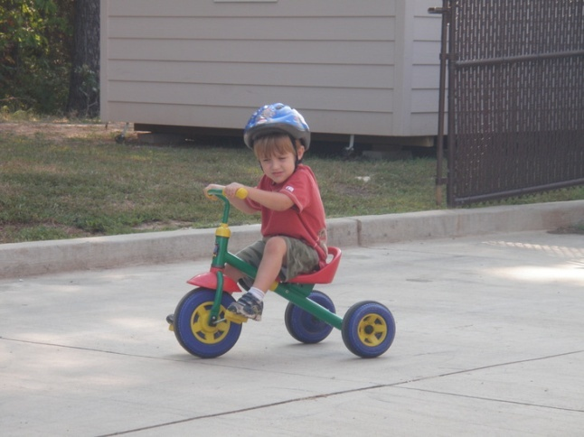
4. Follow the Guidance
Use the activity chart
Dose = Concentration x Breathing rate x Time
  Concentration – amount of pollutant in air
  Breathing rate – how fast you breathe
  Time - time spent outdoors
Pay attention to symptoms
Notes:
so someone can get a high dose from high exertion over a short period of time (e.g., 1 hour) or prolonged moderate exertion
C - be active outdoors when air quality is better
V - take it easier when active outdoors
T - spend less time being active outdoors
Pay attention to symptoms- everyone reacts differently and some students are more sensitive to air pollution-
People with asthma – follow asthma action plan
Coaches/PE teachers – rotate players frequently

Slide 11
Activity Guidelines
r
GOOD Great day to be active outside!
MODERATE Good day to be active outside! Students who are unusually sensitive to air pollution could have symptoms.*
UNHEALTHY FOR SENSITIVE GROUPS It’s OK to be active outside, especially for short activities such as recess and PE. For longer activities such as athletic practice, take more breaks and do less intense activities.
Watch for symptoms and take action as needed.*Students with asthma should follow their asthma action plans and keep their quick-relief medicine handy.
UNHEALTHY For all outdoor activities, students should take more breaks
and do less intense activities. Consider moving activities indoors or rescheduling. Consider moving longer or more intense activities indoors or rescheduling them to another day or time.
VERY UNHEALTHY Move all activities indoors or reschedule to another day.
Notes:
Guidelines are specific to children
we always promote activity when it’s safe to do so
Q: Do you ever change outdoor activities at school based on the weather?

Slide 12
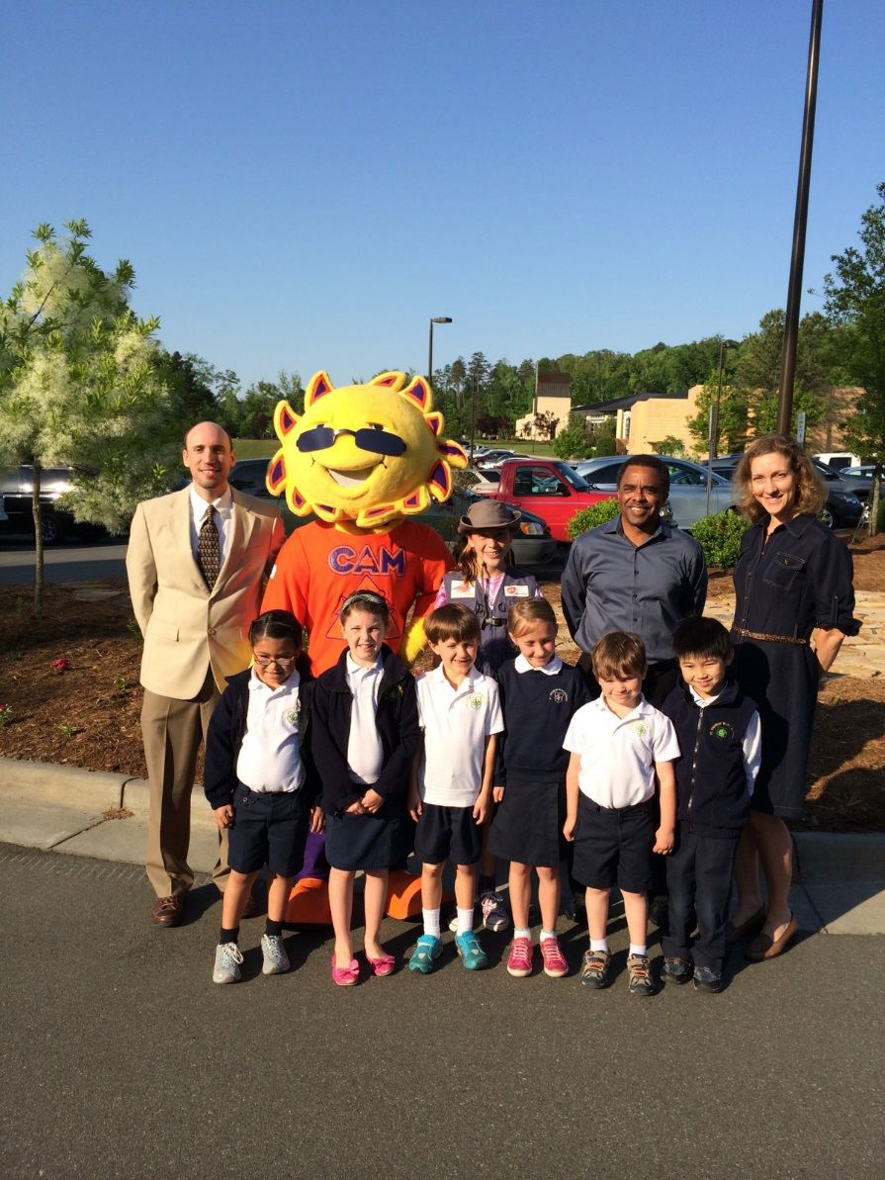
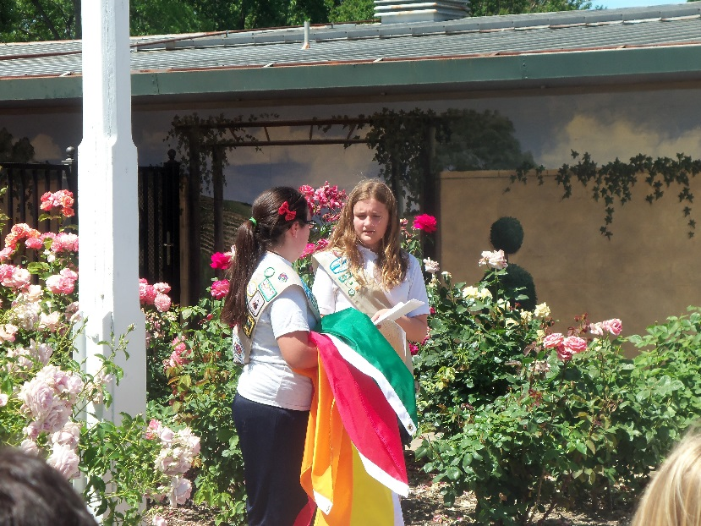
Time for Fun
Events,
games,
contests,
and more!
Notes:
The Air Quality Flag program shows that learning about air quality doesn’t have to be boring, and relates directly to what kids are learning about in the classroom.
We’ve provided guidance for the Girl Scouts and their Journeys information

Slide 13
Flag Website
www.airnow.gov/flag
Fact sheet
Coordinator’s handbook
Parent letter
Lesson plans
Poster
Press release template
Student activities
Registration form
List of participating organizations
Notes:
We have supporting info for each of the steps- in a section on the website just for schools.
Schools shouldn’t have to create anything new- everything you need should be there. Several of these products were created after requests from schools. However, if there’s something you need and you can’t find it, let us know!
13

Slide 14

Other Air Quality Resources
More resources are available at www.airnow.gov/teachers:
  Online curricula
  Interactive games
  Air quality simulator
  Children’s online picture book
Notes:
There are a number of air quality educational resources available for students and teachers in grades K-12. Many can be found on the AirNow website.
Some examples are:
AirNow for Kids – uses colorful characters with narration, music and interactive games
AQI Toolkit for Teachers – hands on activities
Why is Coco Orange? – children’s book about why Coco is orange…he and his friends solve the mystery as they learn about air quality
Air Pollution: What’s the Solution – Grades 6-9 uses real time data to make the air clean or dirty
Smog City 2 – user manipulates emission sources, weather, etc. and sees the effects on the city scape
Order free resources including the children’s book and poster from NSCEP (National Service Center for Environmental Publications).

Slide 15
For More Information:
Donna Rogers, Team Lead- rogers.donna@epa.gov
Melissa Payne, Outreach- payne.melissa@epa.gov
Notes:
Any more questions?

